Slide 1

Assignment 1 – COMP-472
James Partsafas - 40170301,
Ghaith Chrit - 40114180,
Samuel Collette - 40175048

Slide 2
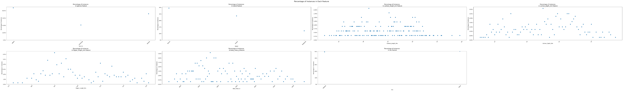
Analyzing Penguin dataset

Slide 3
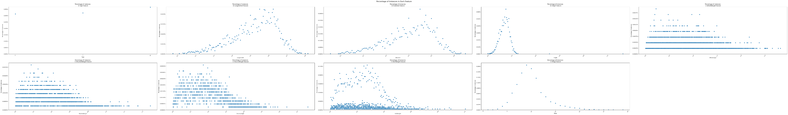
Analyzing Abalone dataset

Slide 4
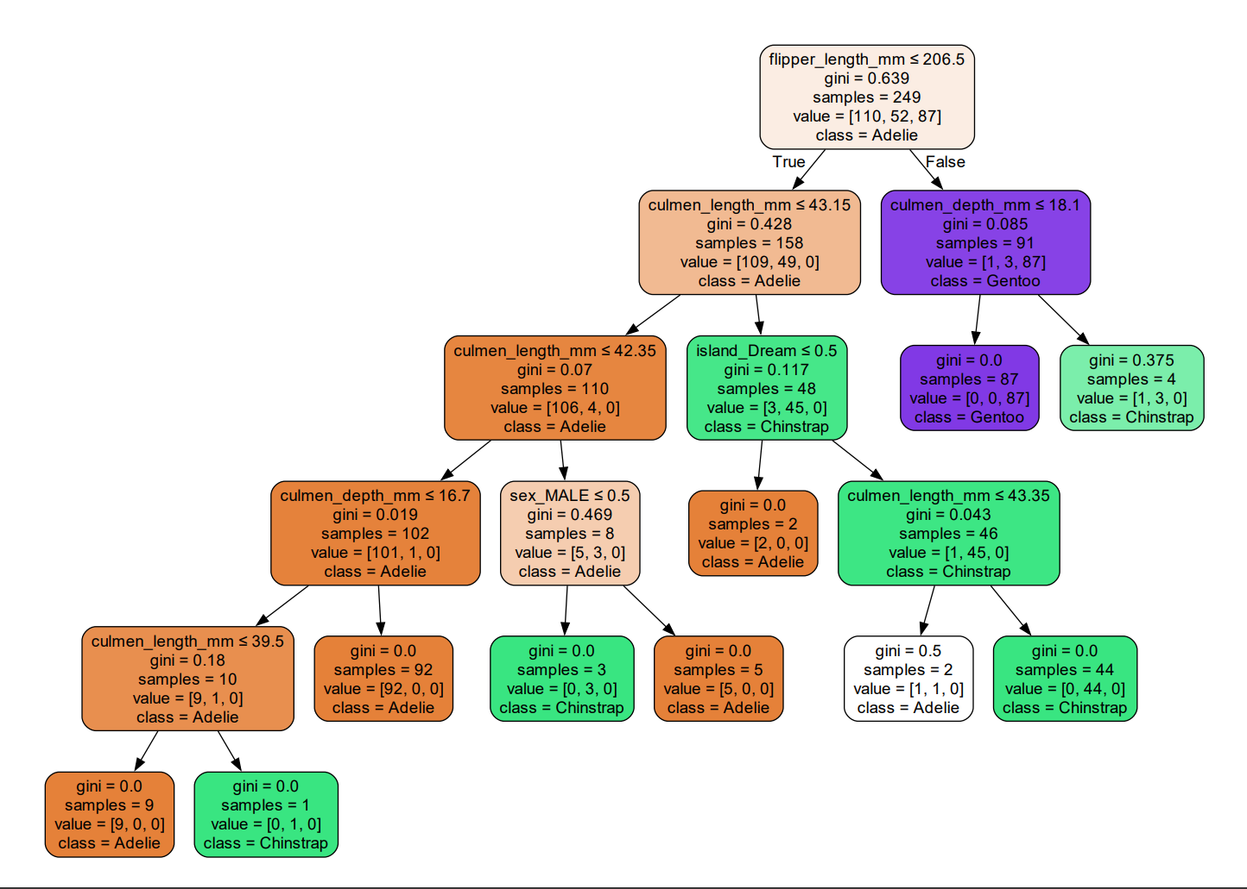
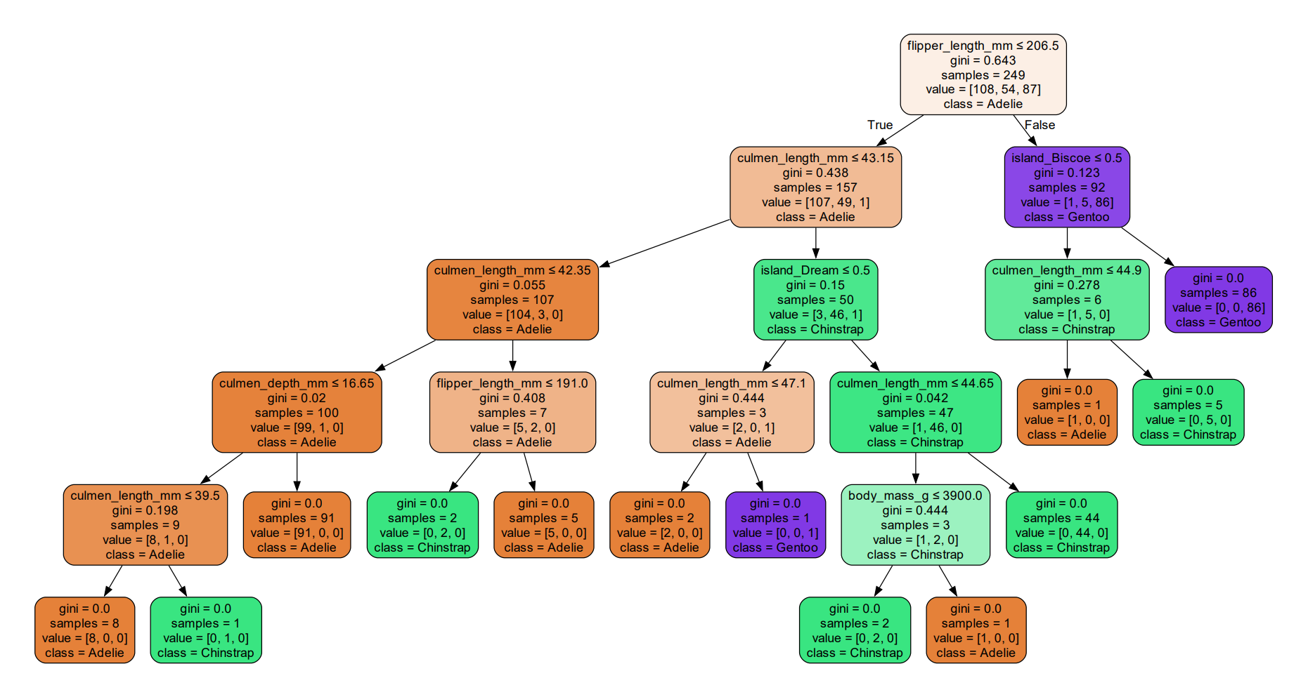
Decision trees for Penguin dataset

Slide 5
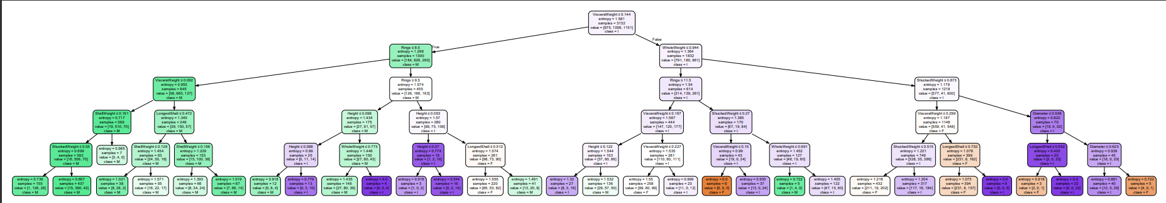
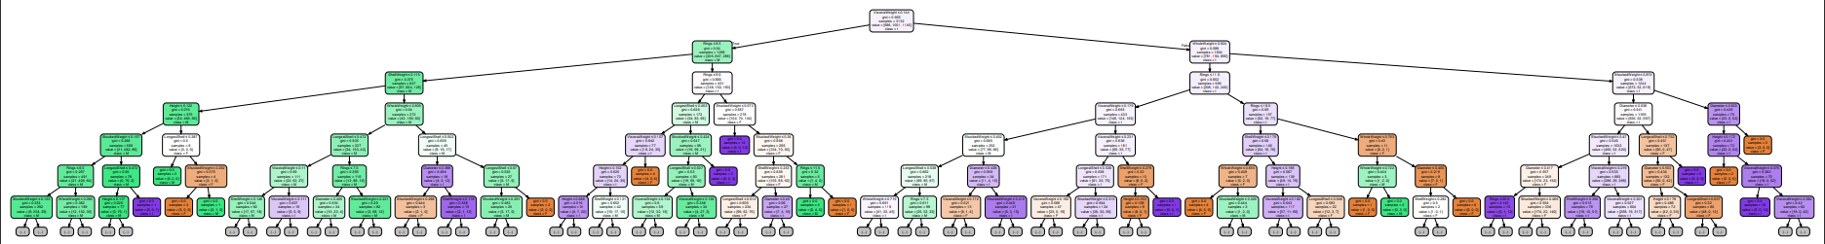
Decision trees for Abalone dataset

Slide 6
Hyper parameters used for Top-DT
Criterion: gini for abalone data set, entropy for penguin data set
Max depth : 5, 20, None
Min samples split: 5, 8,10

Slide 7
Hyper parameters used for Top-MLP
Criterion: sigmoid and relu for penguin data set, tanh for abalone dataset
Network architectures: (30+50),(10+20+10)
Solver: Stochastic gradient descent, adam

Slide 8
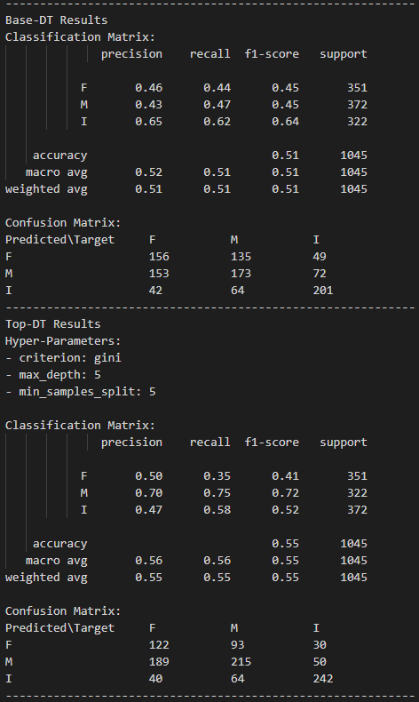
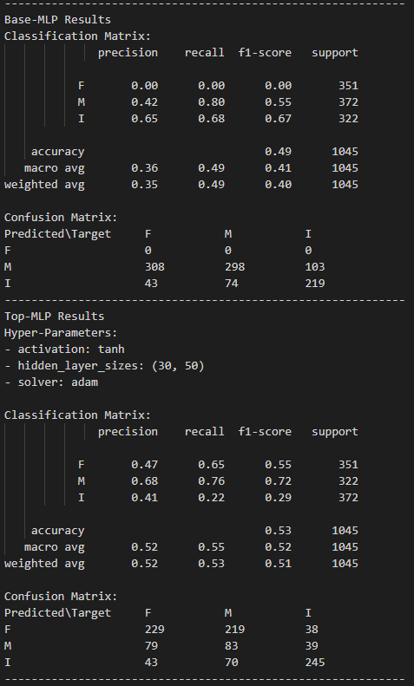
Abalone-performance.txt

Slide 9
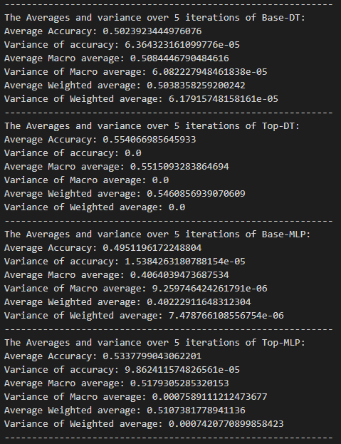

Slide 10
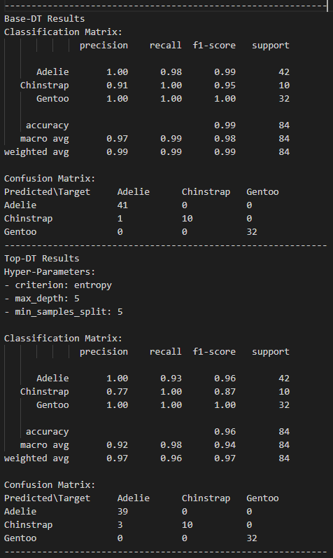
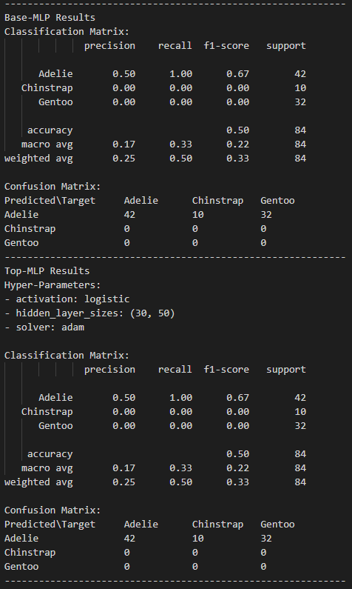
Penguin-performance.txt

